Slide 1
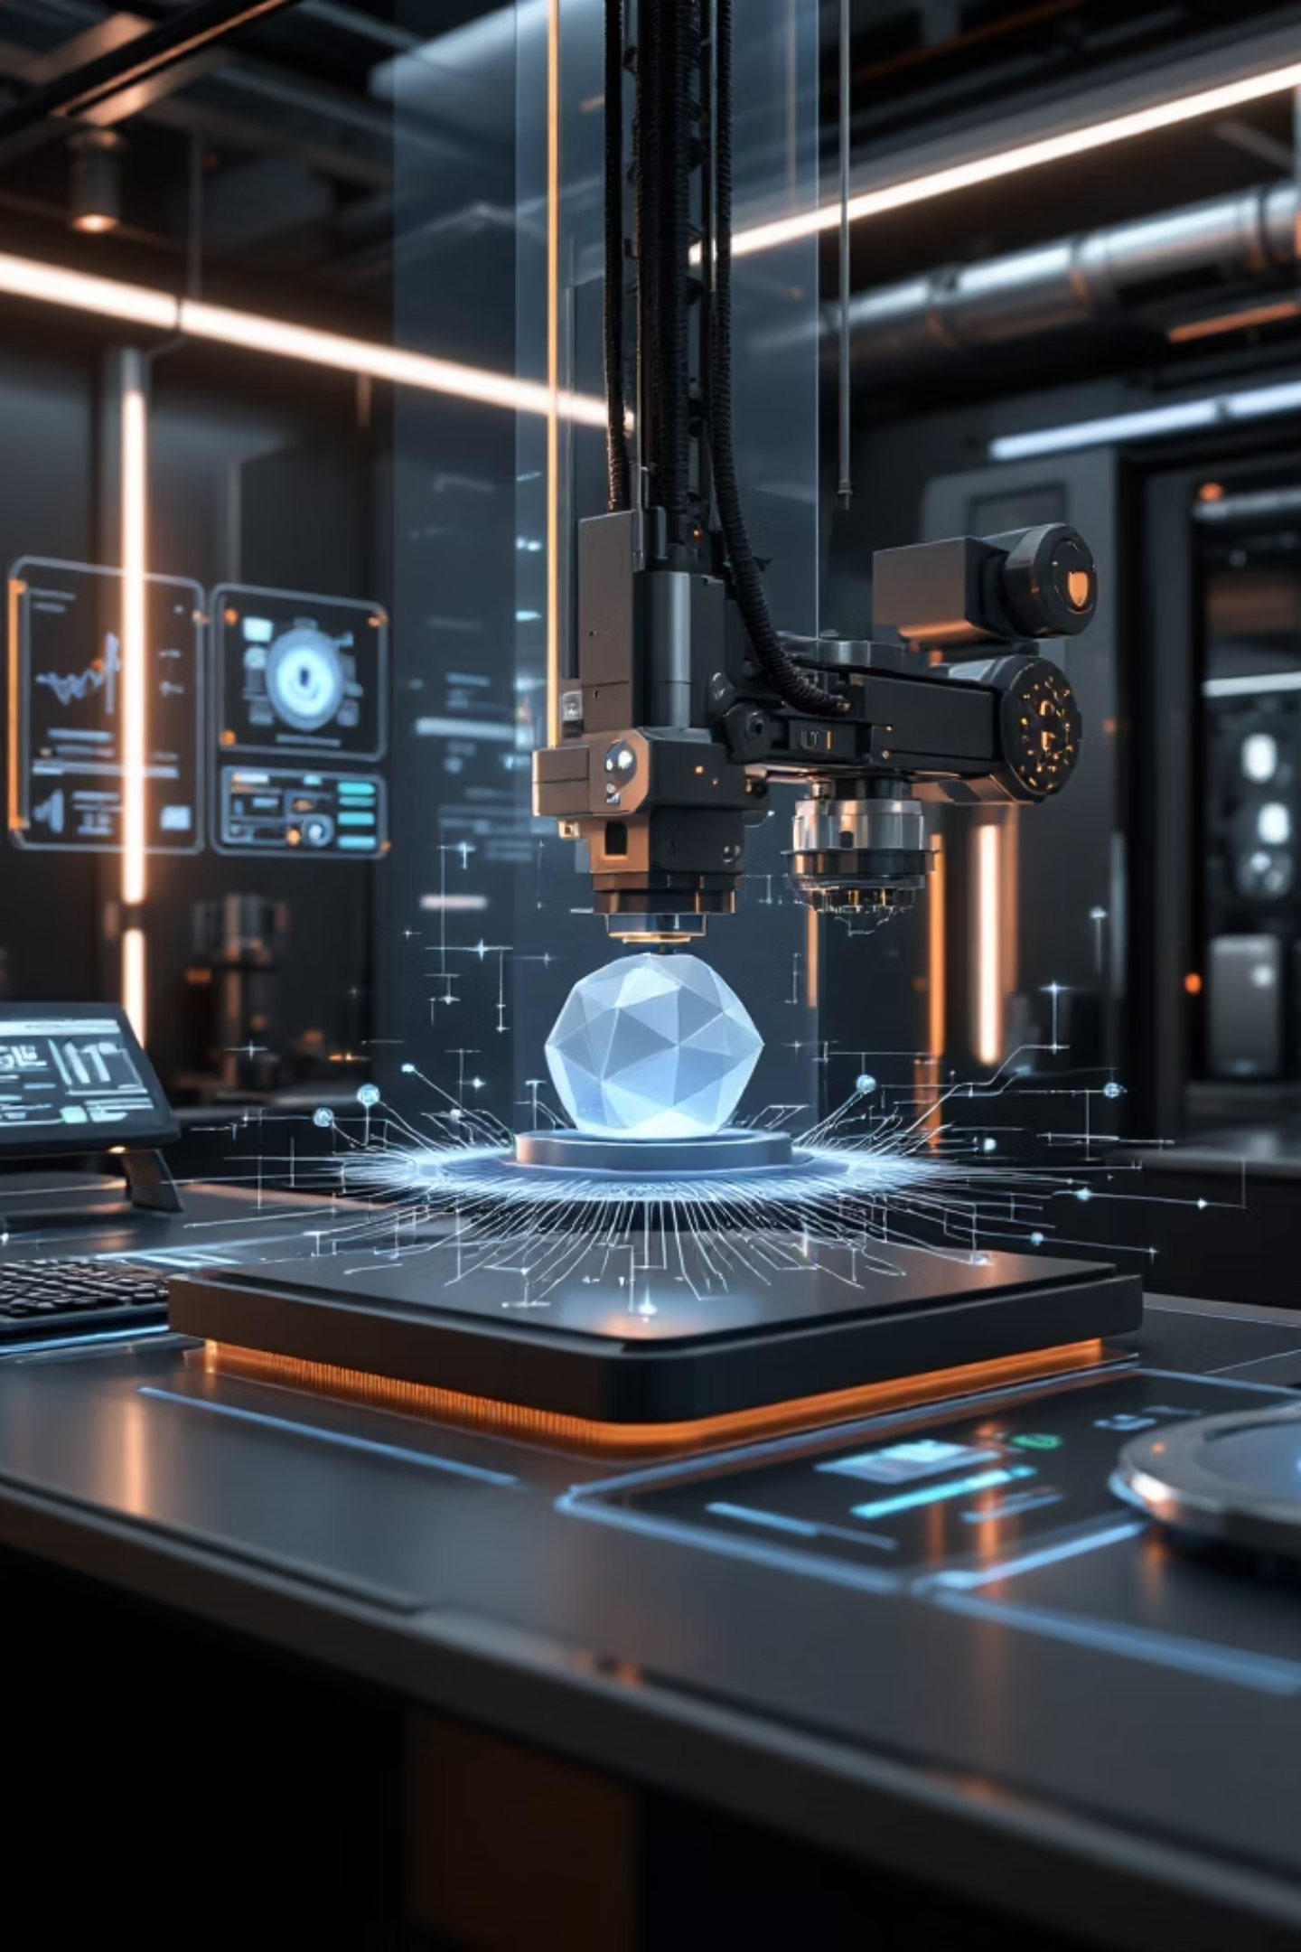
NeuroInkX
AI to 3D Pipeline Demo
R&D Demonstration — Research & Development

Slide 2
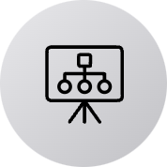

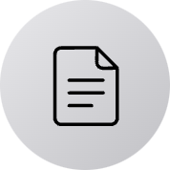



Demonstration Objective
End-to-End Workflow
Pipeline Validation
R&D Deliverables
Demonstrate complete AI to 3D generation pipeline from input to final output
Validate AI-driven system for reliable 3D output generation at scale
Present organized, versioned outputs for comprehensive technical evaluation

Slide 3


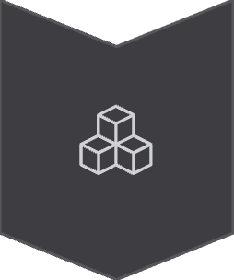

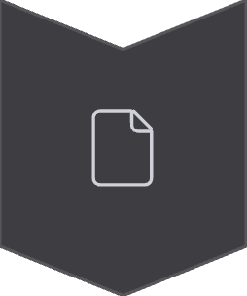
AI to 3D Pipeline Workflow
Input Upload
Source data ingestion and preprocessing
AI-Based Generation
Neural network processes and generates 3D geometry
3D Model Preview
Real-time mesh visualization and validation
Slicing Preview
Layer-by-layer preparation for fabrication
Final Output Summary
Comprehensive metadata and export package

Slide 4
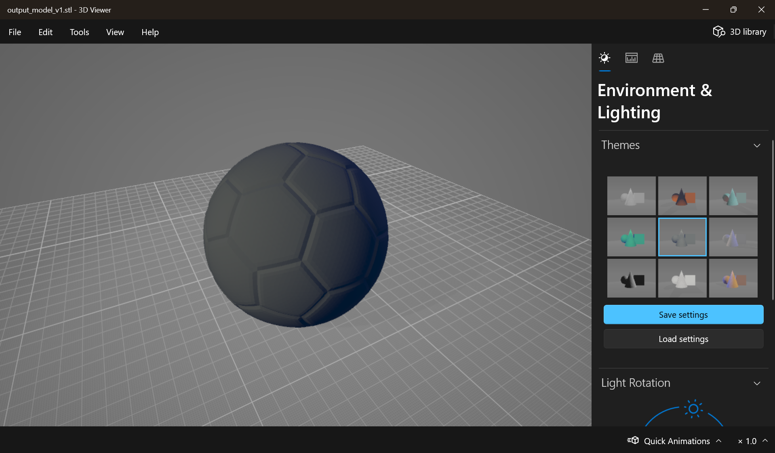
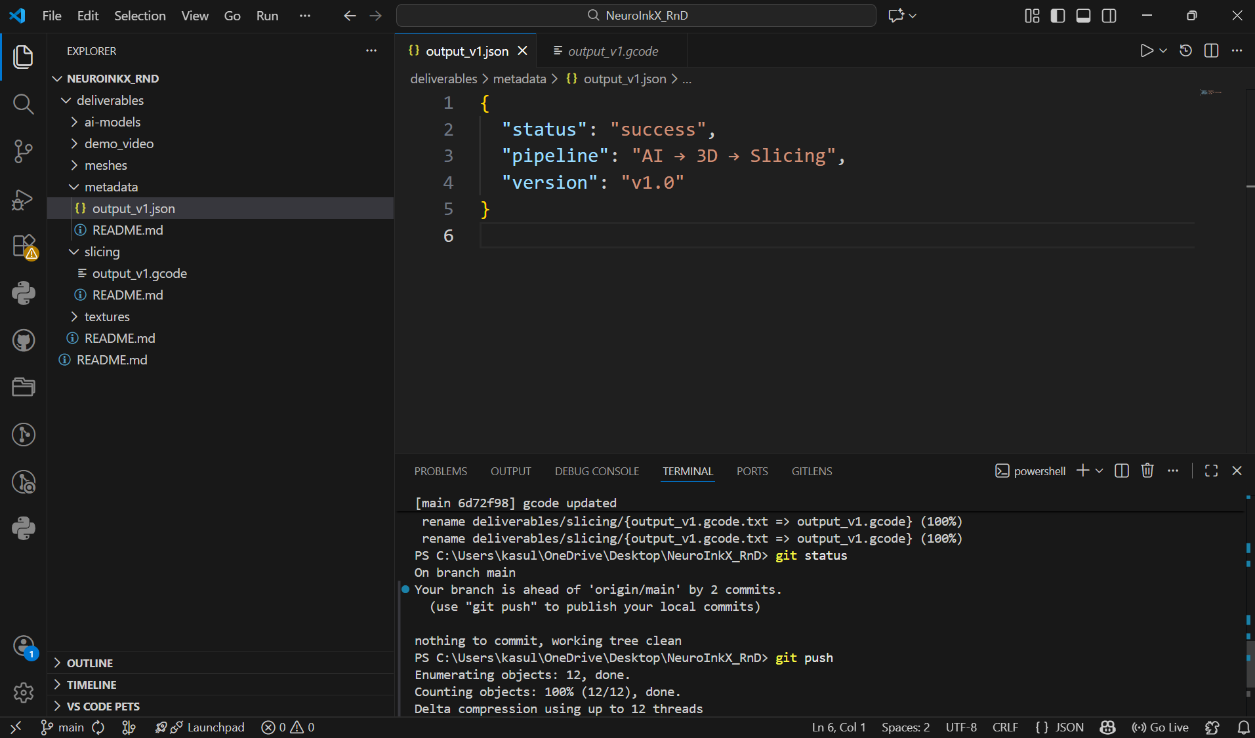
Demo Output Snapshots
Live captures from the AI to 3D pipeline demonstration

Slide 5


Generated Outputs
1
3D Mesh
STL format
Optimized geometry for fabrication
2
Slicing Output
G-code format
Machine-ready instruction set
3
Metadata Summary
All outputs versioned and organized in deliverables repository for reproducibility and audit compliance
JSON format
Complete processing parameters and analytics

Slide 6

Next Steps & Roadmap
01
AI Model Enhancement
Improve accuracy, consistency, and generalization across diverse input types
02
Performance Optimization
Reduce slicing time and processing overhead for production-scale throughput
03
UI/UX Refinement
Streamline interface for improved usability and faster iteration cycles
04
Metadata Extension
Expand analytics capabilities for validation, quality control, and traceability

